Slide 1
Human Activity Recognition
By
Miruna Sureshkumar J

Slide 2
Why Recognize Human Activity?
In the health care ﬁeld, initial detection of diseases could be obtained through long term inquiry of human activity or to stimulate people to be physically active and improve their exercise opportunities.
Security and entertainment are others ﬁelds impacted by investigation of human behaviour through mobile phone data. Mobile phones were used in police investigations to track suspects and victims.
This project is to evaluate a new approach of feature selection along with the PCA technique and compare the performance of several machine learning techniques for activity monitoring.

Slide 3
Dataset
The data is composed by six activities (walking, walking upstairs, walking downstairs, sitting, standing, laying) and 561 features extracted from gyroscope and accelerometer signals present in a smartphone.
These activities were performed by 30 volunteers, with each person wearing a smartphone on the waist, within an age bracket of 19-48 years.

Slide 4
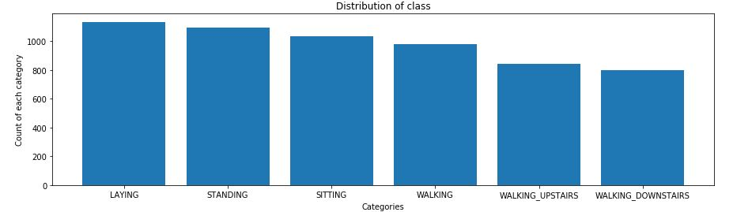

Slide 5
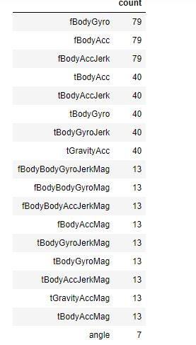

Slide 6
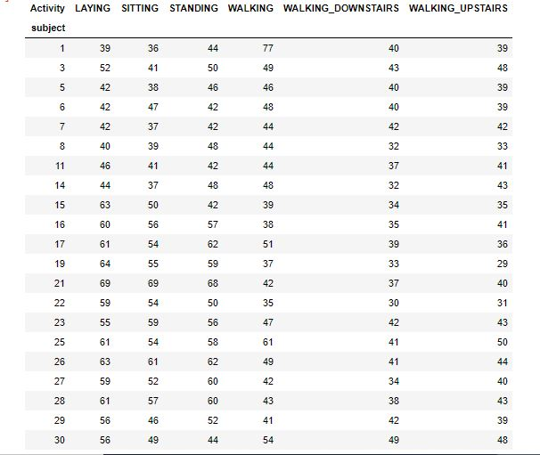

Slide 7
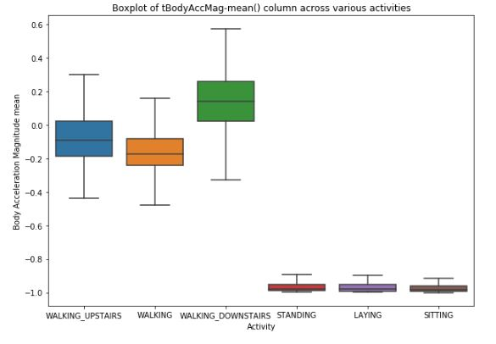

Slide 8
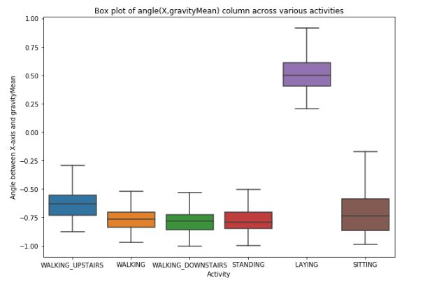

Slide 9
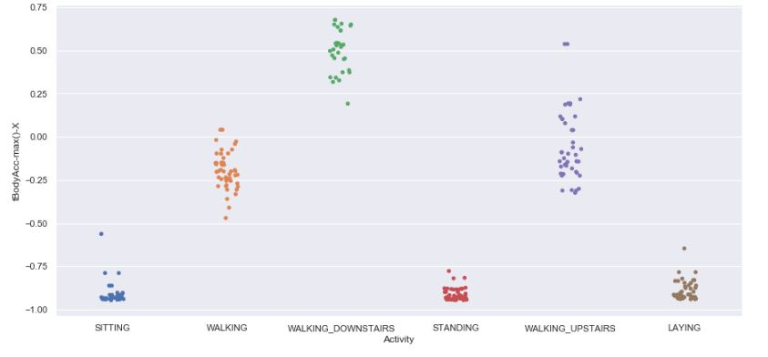

Slide 10
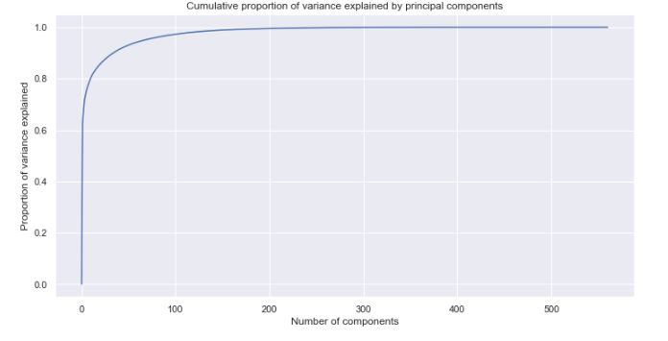

Slide 11
TSNE
t-distributed Stochastic Neighbor Embedding.
t-SNE is a tool to visualize high-dimensional data.
It converts similarities between data points to joint probabilities and tries to minimize the Kullback-Leibler divergence between the joint probabilities of the low-dimensional embedding and the high-dimensional data.
t-SNE has a cost function that is not convex, i.e. with different initializations we can get different results.

Slide 12
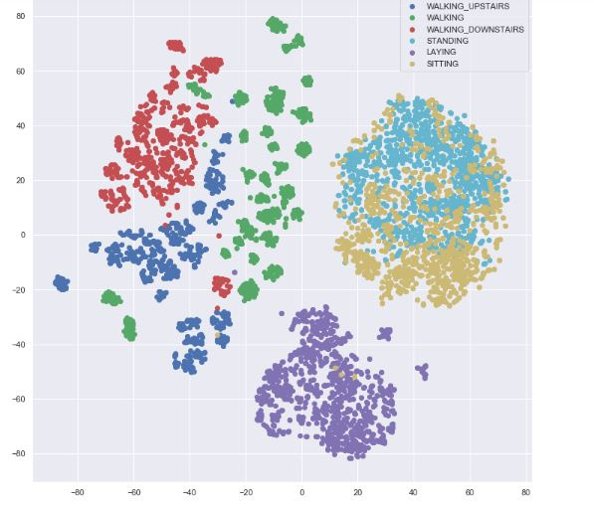

Slide 13
Model Comparison
MLP SGD Solver | Accuracy | Precision | Recall
With PCA | 0.6614 | 0.65 | 0.66
With Tree Based Selection | 0.9687 | 0.97 | 0.97

Slide 14
MLP Adam Solver | Accuracy | Precision | Recall
With PCA | 0.6594 | 0.65 | 0.66
With Tree Based Selection | 0.9843 | 0.98 | 0.99

Slide 15
KNN Classifier(k=5) | Accuracy | Precision | Recall
With PCA | 0.7199 | 0.72 | 0.72
With Tree Based Selection | 0.9605 | 0.96 | 0.96

Slide 16
KNN Classifier (k=11) | Accuracy | Precision | Recall
With PCA | 0.6614 | 0.65 | 0.66
With Tree Based Selection | 0.9687 | 0.97 | 0.97

Slide 17
Voting Classifier | Accuracy | Precision | Recall
With PCA | 0.70 | 0.69 | 0.70
With Tree Based Selection | 0.9748 | 0.98 | 0.97

Slide 18
Random Forest | Accuracy | Precision | Recall
With PCA | 0.7328 | 0.73 | 0.73
With Tree Based Selection | 0.9809 | 0.978 | 0.978

Slide 19


